Slide 1


SCHOOL OF BUSINESS
INDIAN INSTITUTE OF TECHNOLOGY GUWAHATI
Strategic management BM515H
AMAZON
PRESENTED BY:-
BAIBHABA NATH (234024004)

Slide 2

Core Values
Customer Obsession
Ownership
Invent and Simplify
Learn and Be Curious
Hire the Best
The Highest Standards
Think Big
Bias for Action
Earn Trust
Deliver Results
Our vision is to be earth's most customer-centric company; to build a place where people can come to find and discover anything they might want to buy online.
"Amazon is guided by four principles: customer obsession rather than competitor focus, passion for invention, commitment to operational excellence, and long-term thinking. Customer reviews, 1-Click shopping, personalized recommendations, Prime, Fulfillment by Amazon, AWS, Kindle Direct Publishing, Kindle, Fire tablets, Fire TV, Amazon Echo, and Alexa are some of the products and services pioneered by Amazon."

Slide 3
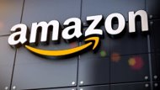
Business Model
Aspect | Description
Products/Services | Their an e-commerce platform that sells a wide range of products, including books, electronics, clothing, home goods, and more. It also offers various services, such as Amazon Prime, Amazon Web Services (AWS), Amazon Advertising, and Amazon Music.
Revenue Streams | Their generates revenue through the sale of products and services, as well as through third-party seller fees, subscription fees for Amazon Prime, and fees for AWS usage.
Customer Segments | Their customer base includes individuals, businesses, and government organizations. It serves customers in various countries, with a focus on India, North America and Europe.
Value Proposition | Their value proposition includes a wide selection of products and services, competitive pricing, fast and convenient delivery, and a user-friendly online shopping experience.
Cost Structure | Amazon incurs costs related to product procurement, order fulfillment, marketing and advertising, technology development and maintenance, and general overhead

Slide 4
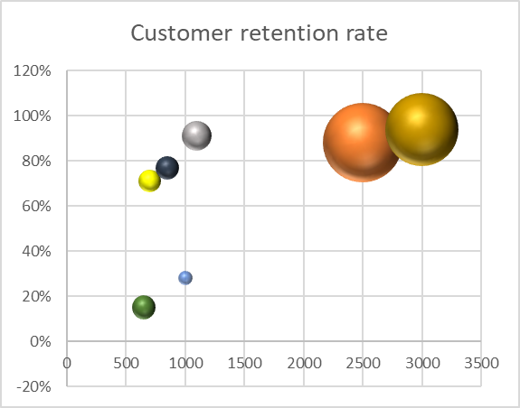
Strategic Group Mapping
MYNTRA
Amazon
Flipkart
Relaince digital
Tata cliq
Shopclues
PAYTM
 | Average order value | Customer retention rate | Market Share
Flipkart | 2500 | 88% | 31.90%
Amazon | 3000 | 94% | 31.2%
Shopclues | 1000 | 28% | 1.03%
Paytm Mall | 650 | 15% | 3.3 %
Myntra | 1100 | 91% | 4.70%
Tata cliq | 700 | 71% | 3%
Reliance digital | 850 | 77% | 3%
Refrence:
https://www.spglobal.com/marketintelligence/en/news-insights/latest-news-headlines/flipkart-is-no-1-in-india-but-faces-formidable-foe-in-amazon-say-experts-54083920

Slide 5

SWOT ANALYSIS
S
W
Strength
Robust logistics and distribution systems, IT systems (Amazon Web Services)
Network of Large number of third-party sellers
Cost effective – no physical retail stores
Weakness
successful brand image – globally
Innovative with products – alexa, solimo, drone delivery
extensive product mix – 75 million products
High market capitalization & global presence
Product failures like – Kindle (unsustainable)
Imitable model : flipkart, meesho
Thin profit margins, including Amazon prime
Inhumane work conditions
Dependence on distributors

Slide 6
O
T
Opportunity
Expanding physical stores in India
More acquisitions of e-commerce companies, Grocery in Tier-2 cities
Supply chain strengthen – ex. Next day prime delivery in Guwahati
Better backward integration to increase margins & develop capability for physical stores
More marketing for new products like Prime music like spotify
Autonomous driving vehicles in India like US
Threats
Aggressive competition ex meesho, Netflix
Fake products, complaints tarnishing brand image
Government regulations – favoured to local companies
Hyperlocal deliveries, specialized platforms for merchandise
Online frauds and phishing attacks

Slide 7
VRIN
Parameters​ | Valuable​ | Rare​ | Inimitable​ | Non-Substitutable​
Brand Value | Yes (sustainable) | Yes (sustainable) | No | Yes (non-sustainable)
Innovation (Home brands/Prime) | Yes (sustainable) | Yes (non-sustainable) | No | No
IT Framework & Digital Tech (Amazon Web Services) | Yes (sustainable) | Yes (sustainable) | Yes (sustainable) | Yes (sustainable)
Global Presence & supply chain network/dealer network | Yes (sustainable) | Yes (sustainable) | No | Yes (non-sustainable)

Slide 8
Weighted Competitive Strength
Strength Measure​ | Weight​ | Amazon (Rating)​ | Score​ | Flipkart (Rating)​ | Score​ | Jiomart (Rating)​ | Score​
Delivery Performance Incl. Prime facility/Network | 0.10​ | 10​ | 1.0 | 7 | 0.7 | 8 | 0.8
Countrywide presence (India) | 0.15​ | 10 | 1.5 | 10 | 1.5 | 3 | 0.45
Technical Capability (IT) | 0.30 | 10​ | 3.0 | 6 | 1.8 | 4 | 0.12
Product Innovation | 0.15​ | 10 | 1.5 | 6 | 0.9 | 3 | 0.45
Capital Resources Available | 0.30​ | 10​ | 3.0 | 6 | 1.8 | 6 | 1.8
Brand Image (India) | 0.10​ | 10 | 1.0 | 9 | 0.9 | 3 | 0.30
​Sum | ​1.0 | ​60 | ​11 | ​44 | ​7.6 | ​27 | ​3.92

Slide 9
Pestel analysis
Political Factors : Anticompetitive business practices (2021)
Economic Factors: 2% digital service tax(finance bill 2021-2022),due to covid-19 more consumers shifted to online shopping
Sociocultural factor: Increasing (online buying habits , consumerism in developing countries , Wealth disparity)
Technological Factors: Alexa and AWS (product recommendation leads to increase in sales by 35%),growth in mobile usage in India lead to (mobile app seamless shopping )
Environmental factors : Reducing carbon footprints by( Decarbonizing the supply chain , sustainable packaging , developing more sustainable transportation infrastructure)
Legal factors: Government regulation are evolving, and unfavorable changes could harm ,Amazon layoff(violation of labor laws) , Amazon fined $ 887 million for privacy violations (Europe data protection law )

Slide 10
Diversification Path for Amazon in India – Unrelated Business
The autonomous driving and electric vehicle segment:
Possess generic resources & capabilities – acquires zoox of US
Industry attractiveness and growth potential – yes, also, with increasing govt incentives
Corporate targets for profitability and ROI: high consumer demand for electric vehicles & vision for autonomous vehicles in T1 cities
Contribution to parent company's PPP: clean fuel vehicles, more convenient means of transport, first mover advantage with existing brand name, populous country – high demand

Slide 11
Competitive advantage
Large and diverse product selection (a one stop shop for everything you need )
Economies of Scale
Brand recognition and customer centric approach
Advanced technology and infrastructure
Adaptability with (market change , customer preference) and amazon has expanded from one category to next (books , toys , electronics, apparel , pet products, and groceries )

Slide 12

Porter’s Five Forces Analysis
Threat of New Entrant
(LOW)
customer base (H)
strong brand recognition(H)
Switching Costs(L)
supply chain(H)
Bargaining power of buyers
(HIGH)
Other platforms offer similar products(L)
Indian buyers are more price HHsensitive(L)
Competitive rivalry
(HIGH)
Competition from established players like Flipkart, Shopclues and Paytm Mall
Expanding their services
Continuously innovating
Threat of substitute
(HIGH)
Bargaining power of Suppliers
(LOW TO MODERATE)
Availability of substitutes(H)
Size of the supplier(H)
Switching costs(L)
Other E commerce i.e flipkart (L)
local e-commerce player (M)
Offline Shops (M)

Slide 13
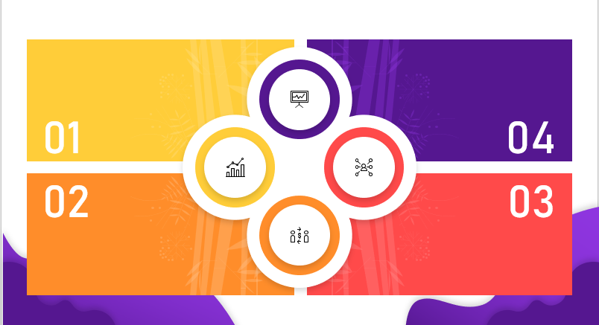
Strategies Used
Amazon has implemented a turnaround strategy to overcome its financial struggles in the early 2000s. The company shifted its focus to e-commerce, expanded its product range, and invested heavily in technology and infrastructure
Amazon's innovation strategy has led to the introduction of new products such as the Amazon Go stores and the Amazon Fire TV Stick
Turnaround Strategy
Innovation Strategy
Diversification Strategy
Acquisition Strategy
e-commerce business
cloud computing services
digital streaming services
hardware products
Amazon has also pursued an acquisition strategy, acquiring companies such as Whole Foods Market and Ring, a smart home security company.

Slide 14
Balance Scorecard
Perspective | Objective | Key Performance Indicators (KPIs) | Target
Financial | Increase revenue and profitability | Revenue growth rate, Net income, EBITDA margin | Revenue growth rate of 20%, Net income growth of 15%
Customer | Provide exceptional customer experience | Customer satisfaction score, Net Promoter Score (NPS), Customer retention | Customer satisfaction score of 90%, NPS of 70
Internal Processes | Streamline operations and improve efficiency | Order fulfillment time, Inventory turnover, Return rate | Order fulfillment time of 2 days, Inventory turnover of 10, Return rate of 5%
Learning and Growth | Invest in innovation and employee development | Employee training hours, Employee engagement score, Number of patents filed | 20 hours of employee training per year, Employee engagement score of 80%, File 100 patents per year

Slide 15
THANK YOU

